Slide 1
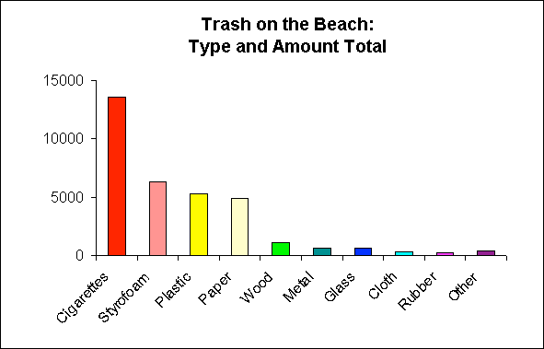
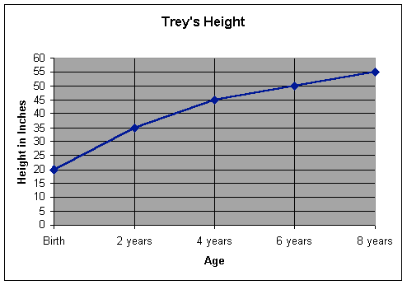
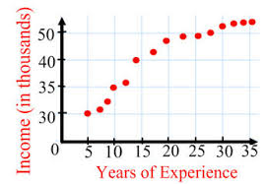
Graphing

Slide 2
Types of Graphs
When recording, organizing, and analyzing data, you may need to put your data into a graph or chart. We are going to talk about four types of graphs/charts...
bar graph
line graph
pie chart
scatterplot

Slide 3
Types of Graphs
bar graph-
compares amounts
line graph-
shows changes of something over time
pie chart-
compares percentages
scatterplot-
shows if two or more things are related

Slide 4
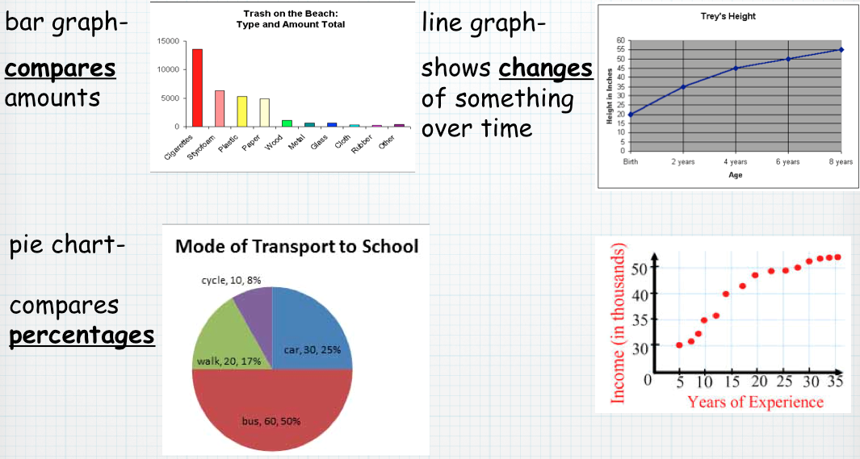
Putting Data in a Graph
Toilet Paper Lab: The data should go in which kind of graph?

Slide 5
Bar Graph

Slide 6
Putting Data in a Graph
Egg Lab: The data should go in which kind of graph?

Slide 7
Line Graph

Slide 8
Putting Data in a Graph
Arm Span/Height Lab: The data should go in which kind of graph?

Slide 9
Scatterplot

Slide 10
Putting Data in a Graph
Jelly Bean Lab: The data should go in which kind of graph?

Slide 11
Pie Chart

