Slide 1
Waves Introduction
Objective: I will understand the difference between mechanical waves and electromagnetic waves.

Slide 2
What is a wave?
A wave is a moving disturbance that transfers energy from one place to another without transferring matter.

Slide 3
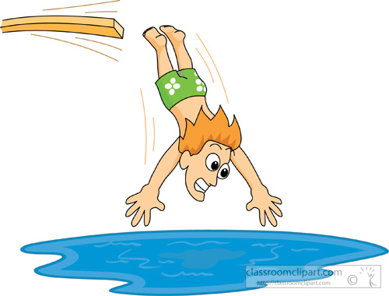
How do waves transfer energy?
Think of a diver in a swimming pool. When a diver hits the water, the impact of the diver exerts a force on water particles. The energy of the falling diver is transferred to the water. This energy then travels through the water, from particle to particle, as a wave.

Slide 4
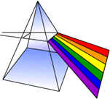
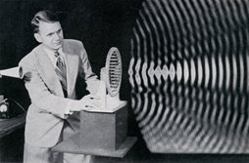
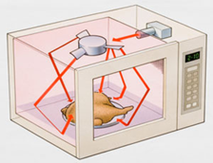
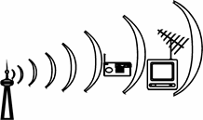
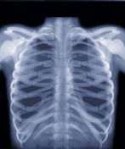
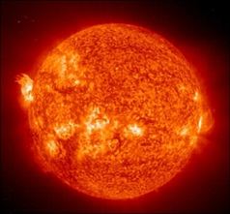
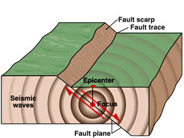
Examples of Waves
Water waves Light waves
Sound waves Microwaves
Radio waves X ray waves
Ultraviolet waves Seismic waves

Slide 5
All of these waves can be put into 2 categories:
Waves that do not require a medium
Waves that require a medium
A medium is something through which a wave travels. (solid, liquid, or gas!)
Most waves need something to travel through. For example, sound waves can travel through air, water, and even solid materials. Water waves travel along the surface of the water. A wave can even travel along an object, such as a rope.
BUT some waves can travel with no medium at all. They can travel through the vacuum of space!
Does light require a medium?

Slide 6
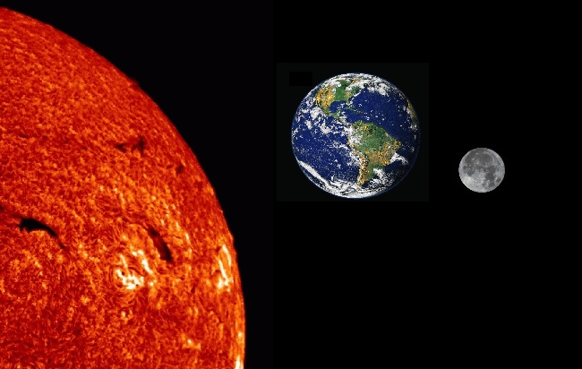
Where does light come from?
If it can travel through NOTHINGNESS, then it doesn’t need a medium.

Slide 7
Back to our 2 groups
Electromagnetic waves can transfer energy through a medium OR through empty space (a vacuum). They do NOT need a medium to travel through.
Ex. Radio waves, light waves, infrared waves, ultraviolet waves, x-rays, gamma rays
Mechanical Waves are waves that DO require a medium in order to transfer energy.
Ex. Sound waves, most water waves, seismic s waves

Slide 8
An electromagnetic wave is made up of vibrating electric and magnetic fields that move through space or some medium at the speed of light.
An electromagnetic wave can begin with the movement of charged particles, all of which have electric fields around them.
As the particles change speed or direction, they vibrate, creating a magnetic field. The vibrations result in an electromagnetic wave. They do not require a medium such as air, so they can transfer energy through a vacuum, or empty space.

Slide 9
Mechanical Waves form when a source of energy causes a medium to vibrate.
Vibration: the wave results when the rocks energy causes the medium to vibrate.
Energy Source:
Rock dropped in the water
Medium: the water

Slide 10
Waves: Transverse and Longitudinal Waves
Objective: I will be able to differentiate between transverse and longitudinal waves.

Slide 11
We have learned that mechanical waves are things like sound waves, water waves, and seismic waves. We know that they require a medium to travel through.
There are TWO types of mechanical waves...
1. Transverse waves
2. Longitudinal waves (compression)
Waves move through mediums in different ways. Depending on how they move, they are either transverse or longitudinal (compression).

Slide 12
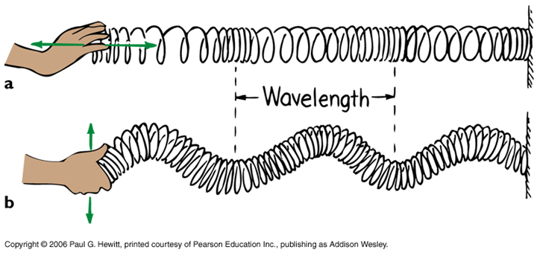
2 different ways to create a wave:
Lets see these two wave types in action:
http://www.acs.psu.edu/drussell/demos/waves/wavemotion.html
Longitudinal
Transverse

Slide 13
Longitudinal Waves
In a longitudinal, or compression wave, the particles of the medium vibrate in the same direction as (or parallel to) the direction that the wave is travelling.

Slide 14
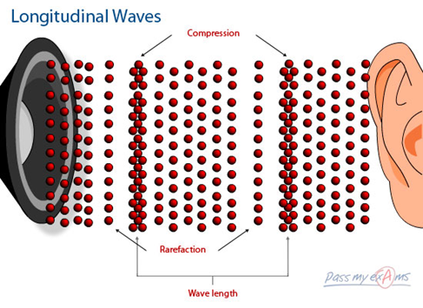
Longitudinal waves (where particles move parallel to the direction of the wave) are something you experience every day in the form of sound.

Slide 15
Transverse Waves
A wave that vibrates the medium at right angles, or perpendicular to the direction in which the wave travels, is called a transverse wave.

Slide 16
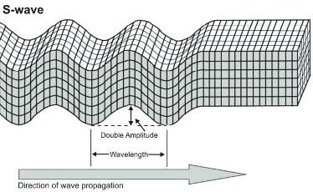
When you make a wave on a rope or shake a blanket, the wave moves from one end of the material to the other. However, the rope/blanket itself moves up and down or from side to side, at right angles in the direction in which the wave travels. These are example of transverse waves. Another example is the seismic S waves that occur during an earthquake.

Slide 17
Assignment 1
Read pages 529-535 in your science textbook, and add to your notes.
Assignment 2
Complete numbers 1-3 on the “Get Ready to Read” worksheet.
Assignment 3
On the back of your “Get Ready to Read Worksheet,” demonstrate your understanding of the two objectives by choosing ONE of the following options…
Write a thoughtful summary in one or two paragraphs
Create a series of concepts maps, graphic organizers, or pictures.
A combination of options 1 & 2
Answer questions 1-8 on page 536.

