Slide 1
Energy Edition

Slide 2
The Prizes
1 - $100
2 - $200
3 - $500
4 - $1,000
5 - $2,000
6 - $4,000
7 - $8,000
8 - $16,000
9 - $32,000
10 - $64,000
11 - $125,000
12 - $250,000
13 - $500,000
14 - $1,000,000

Slide 3
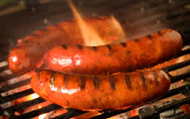
$100
What is the example of radiant
energy in the picture?
C - fire
A - charcoal
B - hot dogs
C - fire
D - wind

Slide 4
$200
Which does NOT have kinetic
energy in the picture? Write all
that apply.
A & B
A - charcoal
B - hot dogs
C - fire
D - wind

Slide 5
$500
The charcoal also has which type
of energy?
B - chemical
A - electrical
B - chemical
C - nuclear
D - none of the above

Slide 6
$1,000
How is nuclear energy is
produced?
A – by splitting/combining nuclei
A – by splitting/combining nuclei
B – through chemical reactions
C – by traveling in waves
D – by burning fuel

Slide 7
$2,000
The vibration and movement of atoms within a substance refers to which type of energy?
D - thermal
A - chemical)
B - electrical
C - acoustic
D - thermal

Slide 8
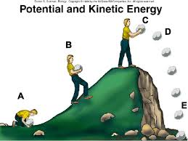
$4,000
At which position does the rock have the most kinetic energy?
E
A
B
C
D
E

Slide 9
$8,000
At which position does the rock have the most potential energy?
C
A
B
C
D
E

Slide 10
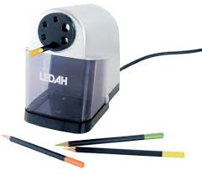
$16,000
What is the energy transformation that is
taking place in an electric pencil sharpener?
B – electrical -> mechanical, acoustic, & thermal
A – nuclear -> electrical -> mechanical & thermal
B – electrical -> mechanical, acoustic, & thermal
C – chemical -> nuclear -> acoustic
D – electrical -> radiant -> thermal & acoustic

Slide 11
$32,000
What is the energy transformation that is
taking place while using megaphone?
B – chemical -> mechanical ->acoustic
A – nuclear -> mechanical -> acoustic
B – chemical -> mechanical ->acoustic
C – acoustic -> mechanical -> chemical
D – mechanical -> acoustic -> chemical

Slide 12
$64,000
What is true of all energy
transformations?
B – The total amount of energy does not change.
A – Some energy is always changed into chemical energy.
B – The total amount of energy does not change.
C – Some energy is always changed into nuclear energy.
D – The total amount of energy can increase or decrease.

Slide 13
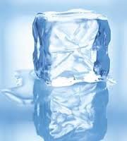
$125,000
Which sentence is NOT true
about the melting ice cube?
D- The mass is changing.
A- The molecules are spreading apart.
B- The molecules are speeding up.
C- The thermal energy is increasing.
D- The mass is changing.
E- The mass is staying the same.

Slide 14
$250,000
Coal, oil, and natural gas are...
Write all answers that apply.
A & B
A – fossil fuels
B – nonrenewable resources
C – renewable resources
D – nuclear energy

Slide 15
$500,000
Which is NOT an example of a
renewable resource?
C– nuclear
A– biomass
B– geothermal
C– nuclear
D– solar
E– wind

Slide 16
$1,000,000
What is true about renewable
energy? Write all that apply.
A, C, & D
A– limitless
B– causes pollution
C– some take up a lot of space
D– expensive
E– more powerful than fossil fuel

Slide 17
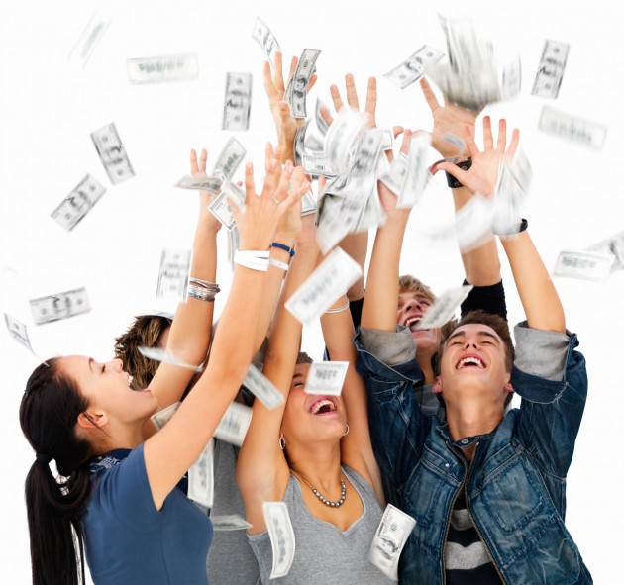
Winner!

