Slide 1
Earth’s Atmosphere

Slide 2
Questions About Air
Balloon Mini Lab- Does air have mass?
Find mass of deflated balloon _____
Find mass of inflated balloon _____
Answer? _____
Air Pressure Mini Lab- Does air have pressure?
Explain or draw what happened in the activity.
Answer? _____

Slide 3
The Atmosphere
The atmosphere is a mixture of gases surround.
List ways the atmosphere helps us survive.
Contains oxygen, carbon dioxide and water
Keeps temperatures stable and at a range that is suitable for living organisms.
Protects us from sun’s harmful UV radiation

Slide 4
The Atmosphere
The atmosphere is made up of…
nitrogen (78%)
oxygen (21%)
other "trace" gases like carbon dioxide and ozone
small solids such as dust, salt, and pollen
liquids like water

Slide 5
Layers of the atmosphere
The atmosphere is divided vertically into layers:
1st/Lowest layer: Troposphere
2nd layer: Stratosphere
3rd layer: Mesosphere
4th layer: Thermosphere
5th /Highest layer: Exosphere

Slide 6
Air Pressure
Gravity pulls the atmosphere toward Earth.
Air pressure is how strongly a column of air is exerting force on an object.
These forces are stronger closer to the Earth’s surface, which makes the air more dense at lower altitudes/elevations and less dense at higher altitudes/elevations.
Which hiker is experiencing a greater amount of air pressure?

Slide 7
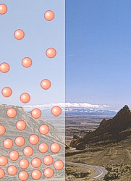
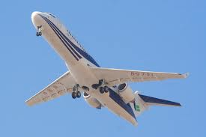
Why can’t we feel air pressure?
Our bodies have adapted to the weight of the air. Our bodies continually adjust as move up and down in altitude.
You can feel your body adjusting at times.

Slide 8
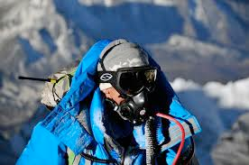
Other Ways Our Bodies Adjust To Altitude
Oxygen levels also decrease as you get higher in the atmosphere.
Altitude sickness, caused by a lack of oxygen, can trigger:
headaches
nausea/vomiting
dizziness
fatigue
It is why you see images like this:

Slide 9
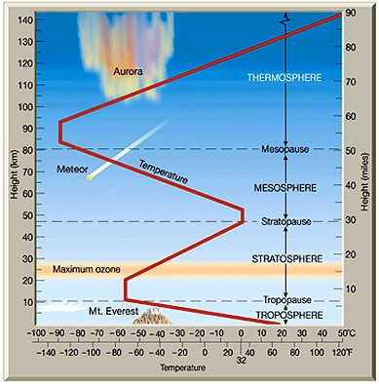
Layers of the atmosphere
The division of layers is mainly based on differences in temperature.
What does this graph tell us about temperature?
Temperature decreases as altitude increases in the troposphere and mesosphere.
Temperature increases as altitude increases in the stratosphere and thermosophere.

