Slide 1
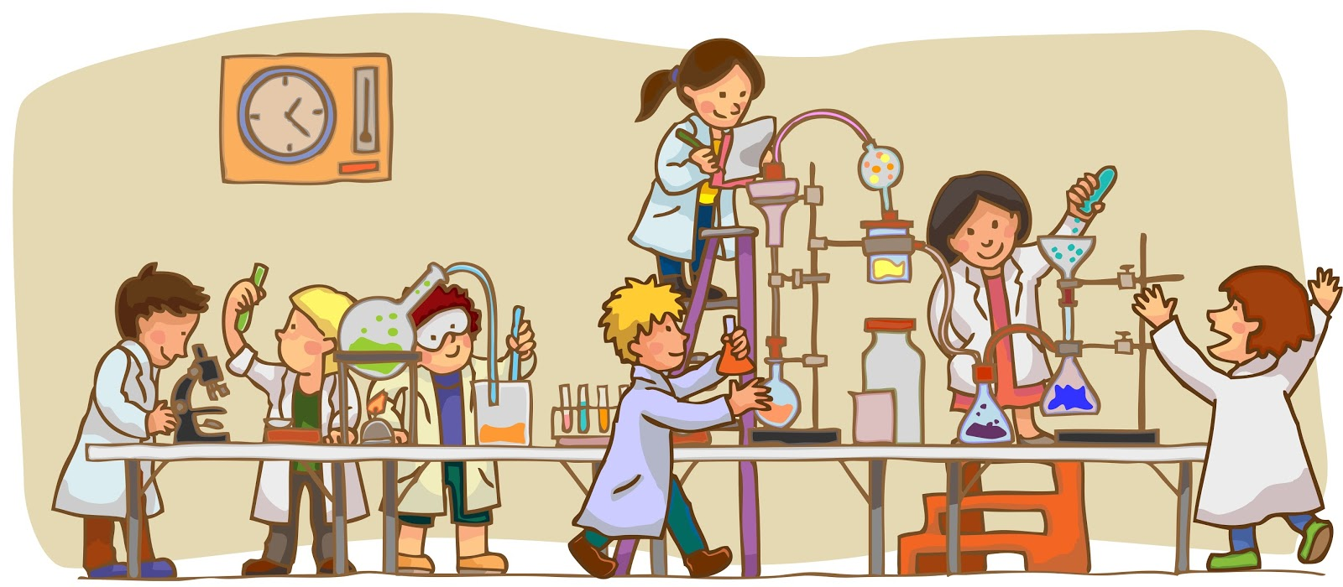
Science Tools Notes

Slide 2
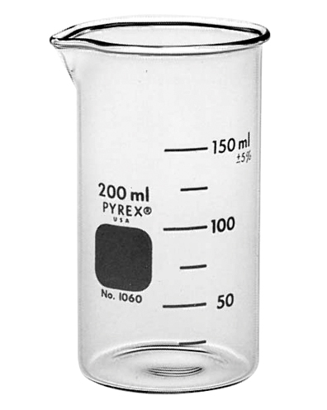
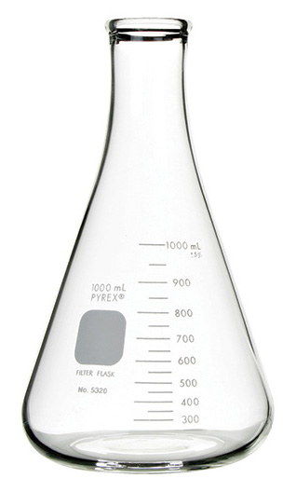
Beaker & Erlenmeyer Flask
Function: To hold/store liquid
Other Important Information
Metric Unit: milliliters (mL)
They are not used for exact measurements because there are not enough lines

Slide 3
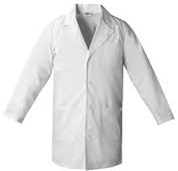
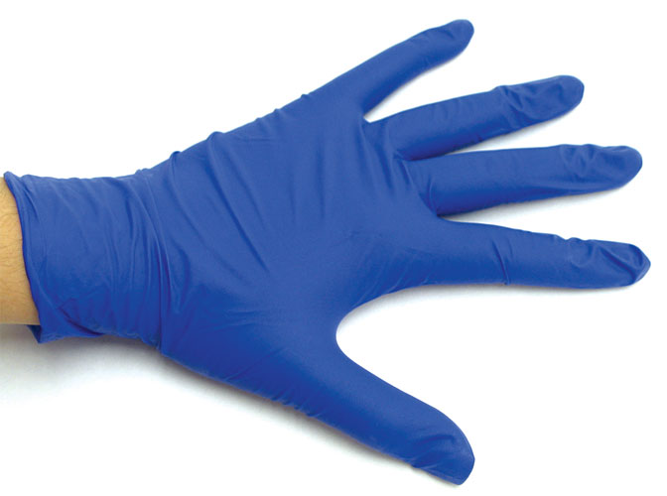
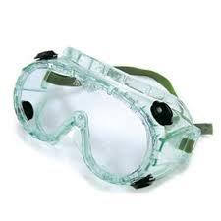
Gloves, Goggles, Lab coat
Function: Eye & skin protection
Other Important Information
If you get an irritant in your eyes or on your skin, go to the eyewash station

Slide 4
Graduated cylinder
Function: To measure the volume of liquids and objects
Other Important Information
Metric Unit: milliliters (mL)
Measure from the bottom of the curve called the meniscus
Water displacement method equation:
________________________________

Slide 5
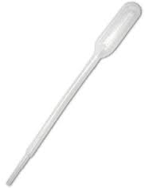
Pipet
Function: To transfer liquids
Other Important Information
Squeeze top, dip in liquid, and transfer

Slide 6
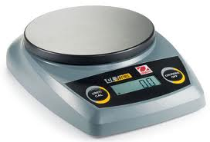
Balance/Scale
Function: To measure the mass of an object
Other Important Information
Metric Unit: grams (g)
Mass is different than weight. (It is not affected by gravity.)

Slide 7
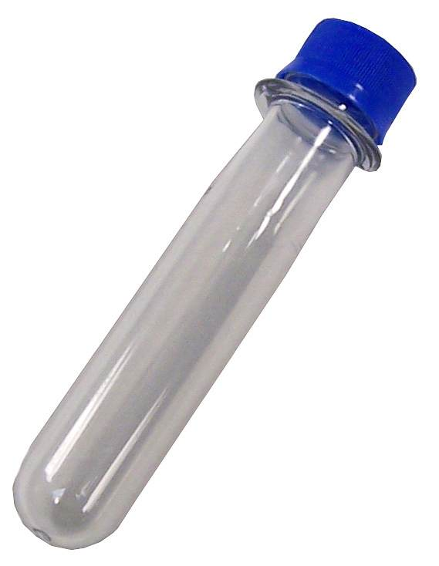
Test Tube
Function: To hold/store liquid and small solids
Other Important Information:
May need to use clamps if liquid is hot

