Slide 1
Wave Relationships
Objective: I can explain how parts of waves relate to each other and to energy.

Slide 2
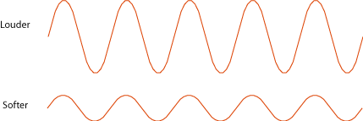
High amplitude means:
1. Louder sounds (if the wave is a sound wave)
2. More energy
Low amplitude means:
1. Softer sounds (if the wave is a sound wave)
2. Less energy

Slide 3
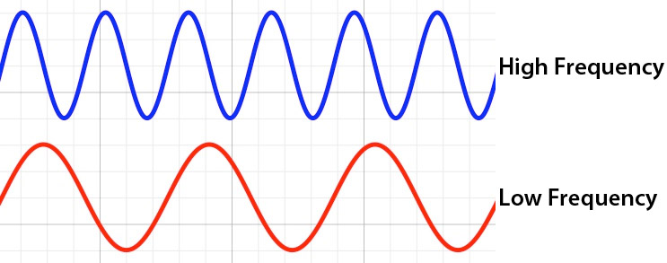
High frequency means:
1. High pitch (if it is a sound wave)
2. Short wavelengths
3. More energy
Low frequency means:
1. Low pitch (if it is a sound wave)
2. Longer wavelengths
3. Less energy

Slide 4
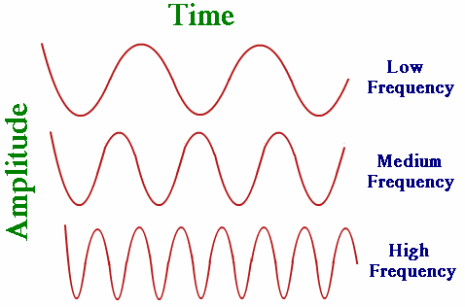
Pitch
When your vocal chords stretch, they vibrate more quickly as air rushed by them. When they are relaxed, they vibrate less quickly. The more quickly they vibrate, the higher pitch they produce. The more slowly they vibrate, the lower pitch they produce.
What is the difference between pitch & loudness? Go to this interactive to find out.

Slide 5
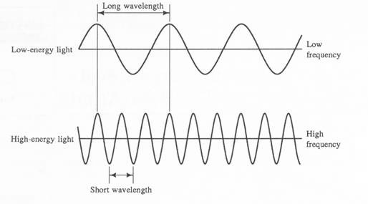
Short wavelength means:
1. High frequency
2. High energy
Long wavelength means:
1. Low frequency
2. Low energy

Slide 6
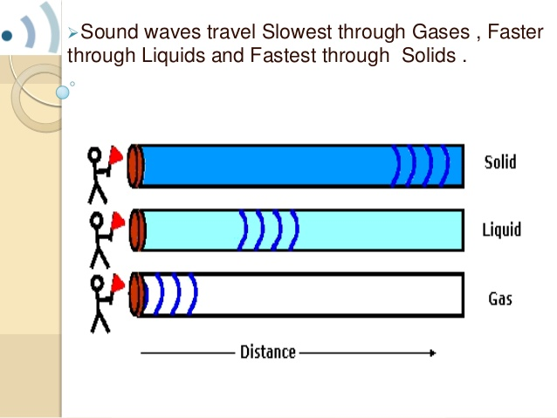
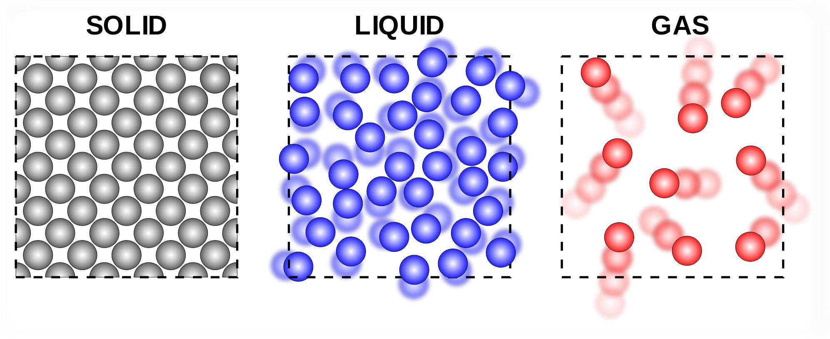
Do the mediums matter? YES!
In mechanical waves, they travel fastest through solids, then liquids, and slowest through gases.
However, in electromagnetic waves, because they do not need a medium to travel, they prefer to not have all those particles in their way. They travel the fastest through gases, then liquids, and the slowest through solids.

Slide 7
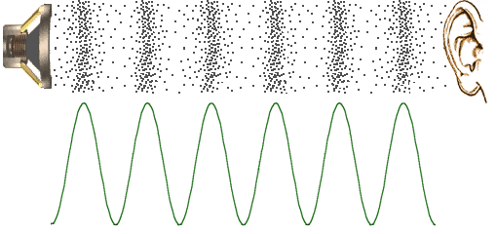
More on Sound Waves
Objective: I will learn more about sound waves and how they travel.
A sound wave begins with a vibration. These vibrations disturb nearby air particles. Like other mechanical waves, sound waves carry energy through a medium without moving the particles of the medium along. Each particle vibrates, and when the vibration reaches your ears, you hear a sound. Sound can travel through air, solids, and liquids.

Slide 8
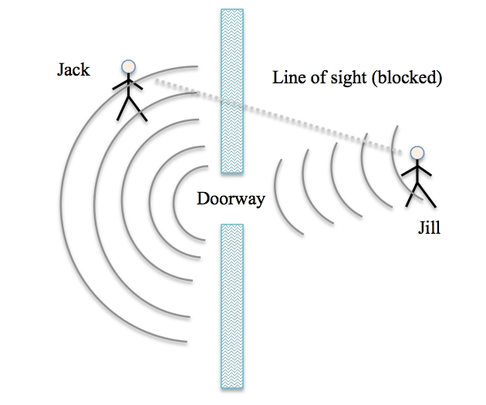
Diffraction of Sound Waves
Sound waves do not always travel in straight lines. Sound waves can diffract, or bend, around the edges of an opening such as a doorway.

Slide 9
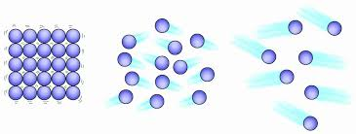
Mediums & Sound Waves
The particles are more condensed in a solid, meaning the wave has more particles to vibrate off of.

Slide 10
Temperature & Sound Waves
In a given liquid or gas, sound travels more slowly at lower temperatures than at higher temperatures. Why? At lower temperatures, the particles of a medium move more slowly. It is more difficult for the particles to move and they return to their original positions more slowly.

Slide 11
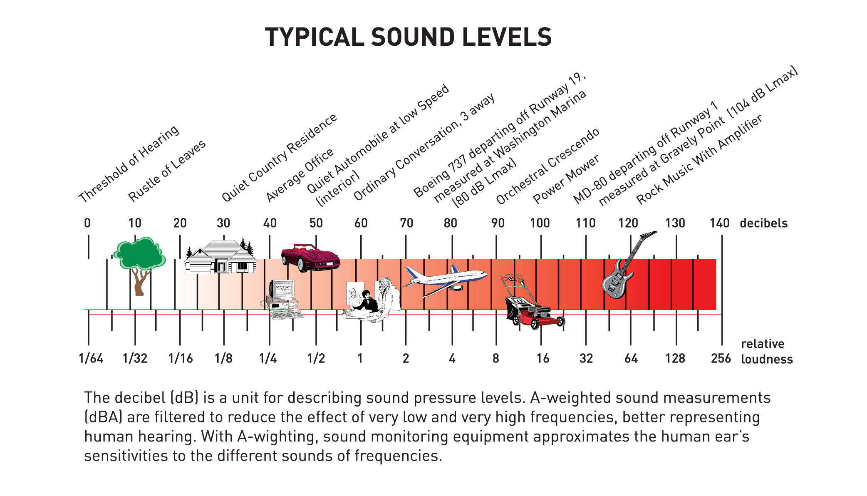
Measuring Loudness
Loudness is measured in a unit called a decibel (dB). Sounds louder than 100 dB can cause damage to your ears, especially for long periods of time.

