Slide 1
Atmosphere and Ocean Currents

Slide 2
What We Already Know Warm Vs. Cool Air/Water
What do we already know about the heating of warm air/water? Fill in the blanks below with the following words:
high, low, sun, wind, sinks, rises, spread apart, closer together, more, less
The air and water on Earth is heated from the ________. Warm air/water _______ while cool air/water _______ (convection). This is because the molecules of warm air/water _____________________ and are _______ dense and cool air/water move _____________________ and are ________ dense. Therefore, we say warm air has _______ pressure and cool air has _______ pressure. This movement of air is called _______.

Slide 3
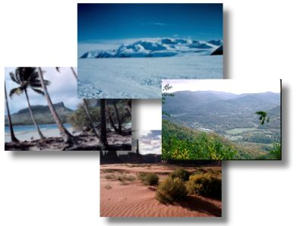
Climate
Climate- the weather conditions of an area over a long period of time
The air currents and ocean currents help regulate Earth's climate and distribute heat around the globe.

Slide 4
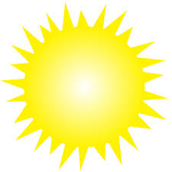
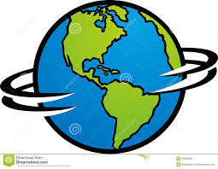
The Sun’s Heat
Does the sun heat the Earth evenly? How do you know?
No, it does not. There are different temperatures in different locations around the Earth. If the sun did heat the Earth evenly, all cities on Earth would have the same temperature.

Slide 5
Air Currents
Air currents are the movement of air due to the sun’s heat and Earth’s rotation. The Earth is heated most directly at the equator. This causes the air at the equator to rise (low pressure). However, because the Earth is rotating it does not appear to rise vertically. Instead, it rises in a diagonal direction. This is called the Coriolis Effect.

Slide 6
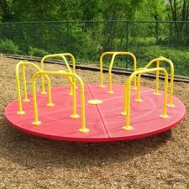
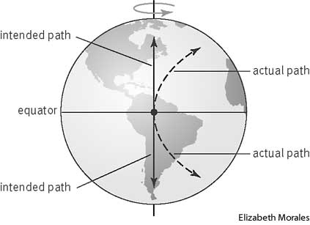
Coriolis Effect
When you think of the Coriolis Effect, think of this fun piece of playground equipment!
Watch the video on the Coriolis Effect to see how it relates.

Slide 7
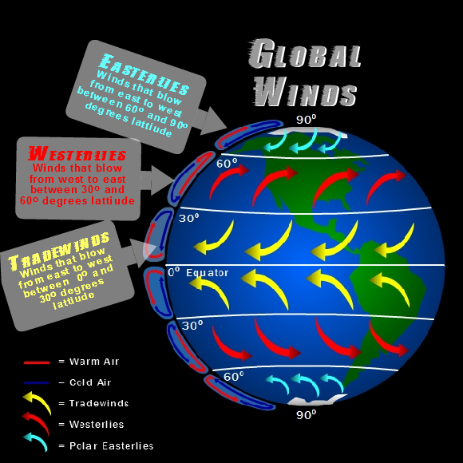
Coriolis Effect
High pressure- cool air sinks
Low pressure- warm air rises
High pressure- cool air sinks
Low pressure- warm air rises
High pressure- cool air sinks
Low pressure- warm air rises
High pressure- cool air sinks

Slide 8
Jet Streams
A jet stream is an area of strong winds ranging from 80-140 mph that can be thousands of miles long, a couple of hundred miles across and a few miles deep. Jet streams usually sit at the boundary between the troposphere and the stratosphere. They form where temperature differences exist.

Slide 9
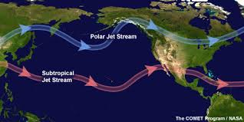
Jet Streams
At most times in the Northern and Southern Hemispheres, there are two jet streams: a subtropical jet stream centered at about 30 degrees latitude and a polar jet stream whose position varies with the boundary between polar and temperate air. Jet streams can bring warmer or cooler air to different places throughout the year.

Slide 10
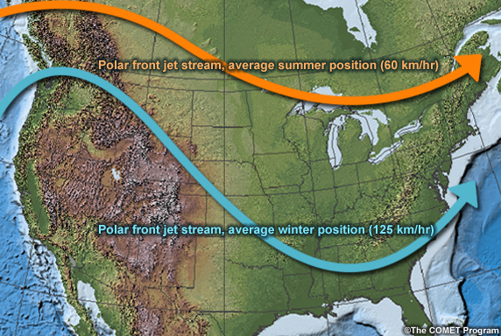
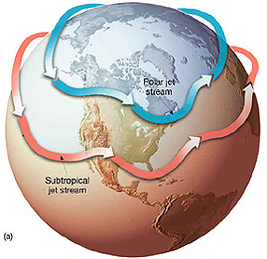
Jet Streams

Slide 11
Ocean Currents
The atmosphere is not the only contributor to climate. The oceans also play a major role. Consider this- England is at the same latitude as Canada, but temperatures in the UK are much more mild year round. In fact, it does not snow regularly in England as it does in Canada. What causes this difference in climate?
The ocean! An ocean current is a large volume of water flowing in a certain direction. Ocean currents can flow horizontally or vertically, and are caused by wind and differences in water density.

Slide 12
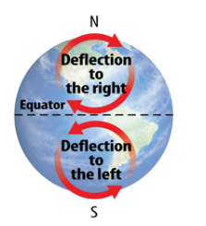
Surface Currents in the Ocean
Wind-driven currents are called surface currents. They carry water horizontally across the ocean’s surface by the Earth’s wind.
The Coriolis Effect causes the air to move water at the ocean’s surface to the right in the northern hemisphere, in a clockwise direction, and to the left in the southern hemisphere, in a counterclockwise direction.
The shapes of continents and other land masses affect the flow and speed of surface currents.

Slide 13
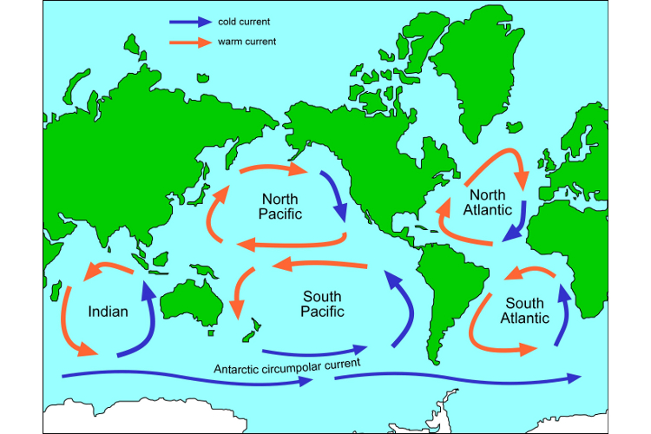
Surface Currents in the Ocean
Large surface currents that move in a circular direction are called gyres. They move big bodies of warm and cool water around the world.
Use the map to explain why London is warmer than Canada.

Slide 14
Gulf Stream Current
Warm, water from the tropics travels along the East Coast of the U.S., across the Atlantic Ocean, and to Europe. This current is known as the Gulf Stream. It causes Europe to have more mild weather than Canada.

Slide 15
California Current
The opposite is true too. The California Current brings cooler water from the Northern Pacific Ocean down to the west coast of the U.S. This causes Hawaii to be cooler than other tropical locations that are at a similar latitude.

Slide 16
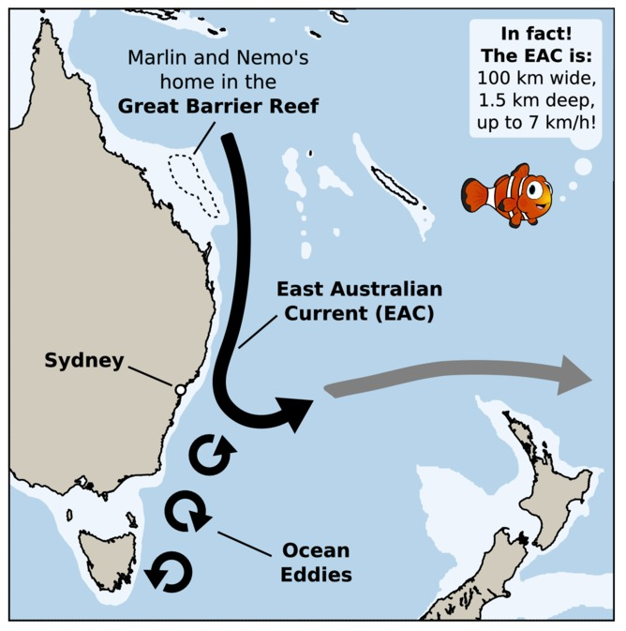
East Australian Current
When you think about currents and gyres, think about the movie Finding Nemo. Marlin and Dori ride with Crush the sea turtles down the Australian faster.
Watch the video clip from the movie.

Slide 17
Deep Ocean Currents
There are also currents deep below the earth surface. Deep ocean currents are driven by differences in water’s temperature and salinity (amount of salt in the water).
In the Earth's polar regions ocean water gets very cold, forming sea ice. When sea ice forms, the salt is left behind, and causes the surrounding water to get saltier. As the seawater gets saltier, its density increases, and it starts to sink. Surface water is pulled in to replace the sinking water, which begins the deep-ocean currents that create the global conveyer belt.

Slide 18
Deep Ocean Currents
The conveyor belt moves at much slower speeds (a few centimeters per second) than surface currents (tens to hundreds of centimeters per second). It is estimated that it takes water about 1,000 years to complete the journey along the global conveyor belt.
The conveyor belt is also an important component of the global ocean nutrient and carbon dioxide cycles. Warm surface waters are depleted of nutrients and carbon dioxide, but they are enriched again as they travel through the conveyor belt as deep or bottom layers. The base of the world’s food chain depends on the cool, nutrient-rich waters that support the growth of algae and seaweed.

Slide 19
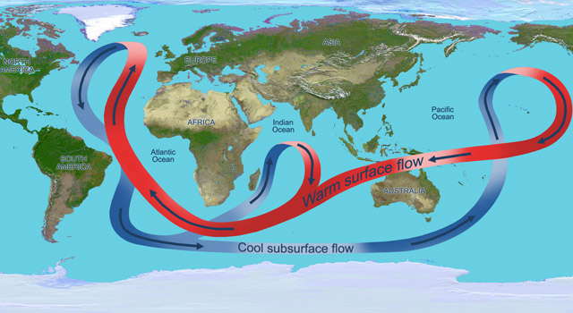
Global Conveyer Belt
Information from http://oceanservice.noaa.gov

Slide 20
Other Videos
Coriolis Effect
Global Conveyer Belt & Gulf Stream

