Slide 1
Earth Systems

Slide 2
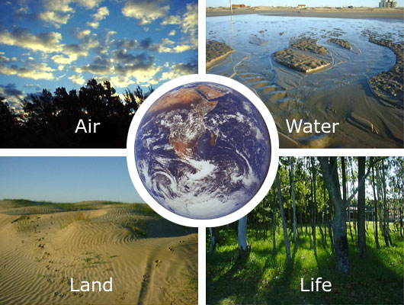
Earth’s Spheres
The Earth is made up of five main interacting systems, which are sometimes called spheres
Atmosphere
Hydrosphere
Cryosphere
Geosphere
Biosphere

Slide 3
Assignment
1. On the front flap of your foldable list the Earth’s five spheres.
2. Read pages 41 & 42 in your Earth science textbook.
3. On the inside base (part with solid lines), take notes of the defining characteristics of each sphere.
4. On the inside flap, draw pictures to represent each sphere.

Slide 4
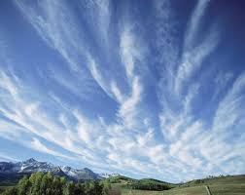
Atmosphere
Layer of gases surrounding Earth
Outermost system
Mixture of nitrogen, oxygen, carbon dioxide, and other gases

Slide 5
Hydrosphere
Liquid water
Ex. oceans, rivers, rain

Slide 6
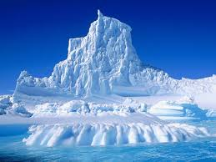
Cryosphere
Frozen water
Ex. glaciers

Slide 7
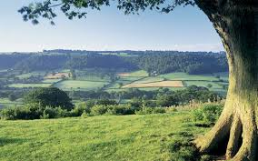
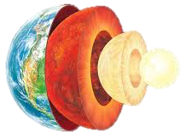
Geosphere
Earth’s body
From crust to core
Largest system

Slide 8
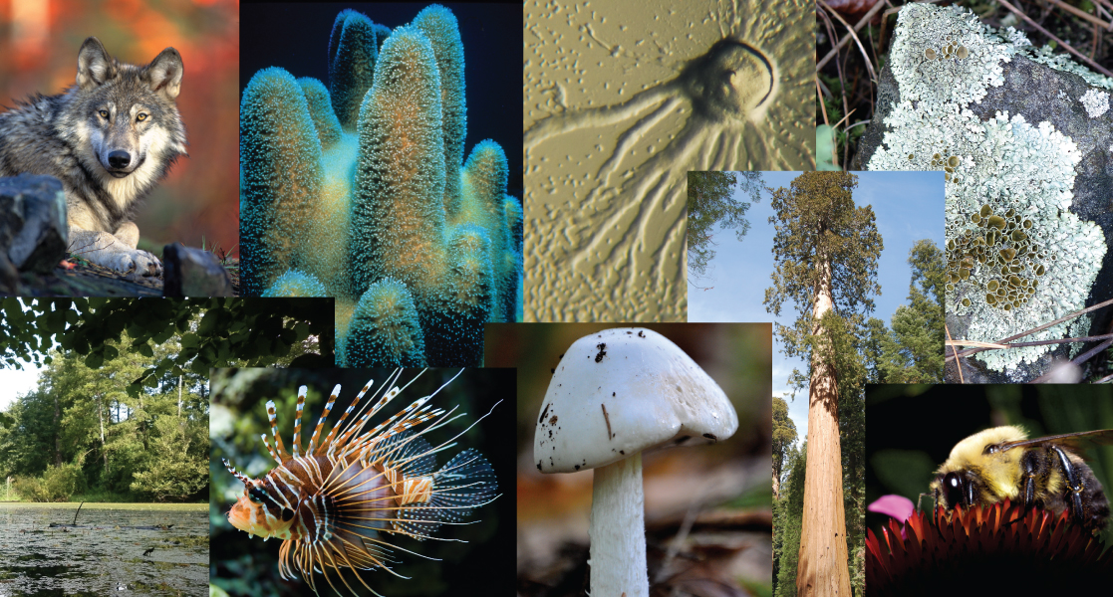
Biosphere
All living things
Ex. animals, plants, fungi, bacteria

Slide 9
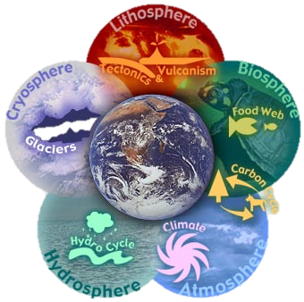
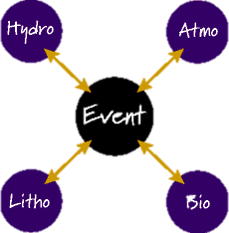
Connection
The five systems are always interacting by exchanging energy and matter.

Slide 10
Directions: Brainstorm a list of ways each of these spheres interacts with the others.

