Slide 1
Layers of the Atmosphere

Slide 2
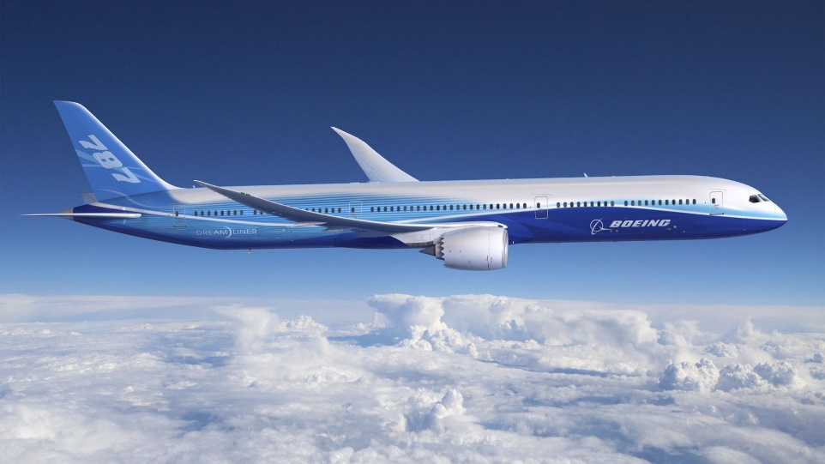
Troposphere
Where all life and land is found
Where weather occurs & planes fly
Means “change,” because gas continuously mix
Most dense layer, 90% of all gases are found here
Temperature decreases with altitude

Slide 3
Stratosphere
Contains the ozone layer, helps absorb sun’s harmful UV rays
Temperature increases with altitude

Slide 4
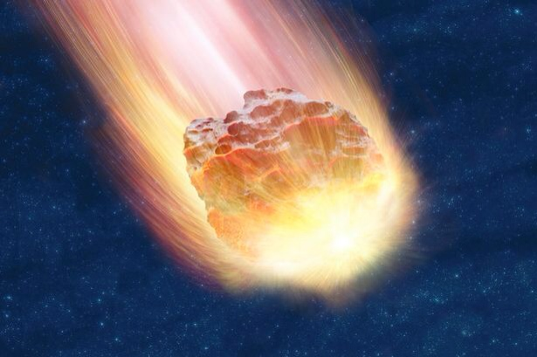
Mesosphere
Meteors disintegrate here
Layer with the lowest temperature
Temperature decreases with altitude

Slide 5
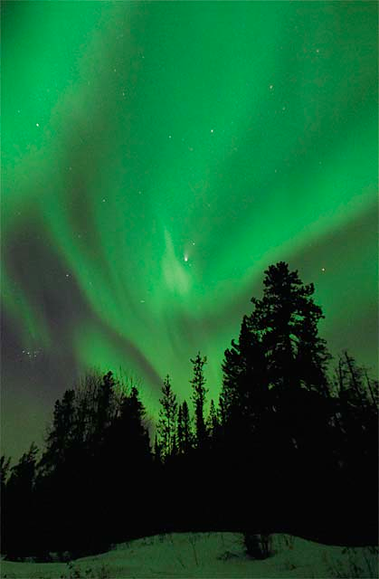
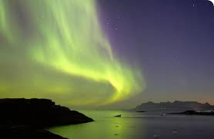
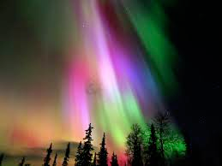
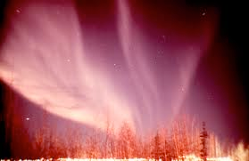
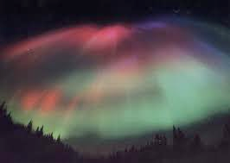
Thermosphere
Contains only 1% of all gases
Contains the ionosphere
Auroras/Northern Lights shine due to charged particles
Layer with the highest temperature
Temperature increases with altitude

Slide 6
Exosphere
Gas molecules rarely strike one another because there are so few
Border between atmosphere & space

